Slide 1
Statistical Analysis
Comparing means

Slide 2
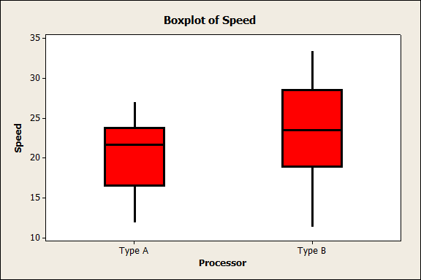
Variable | Processor | N | Mean | StDev
Speed | Type A | 30 | 20.43 | 4.053
 | Type B | 30 | 23.2 | 5.57

Slide 3
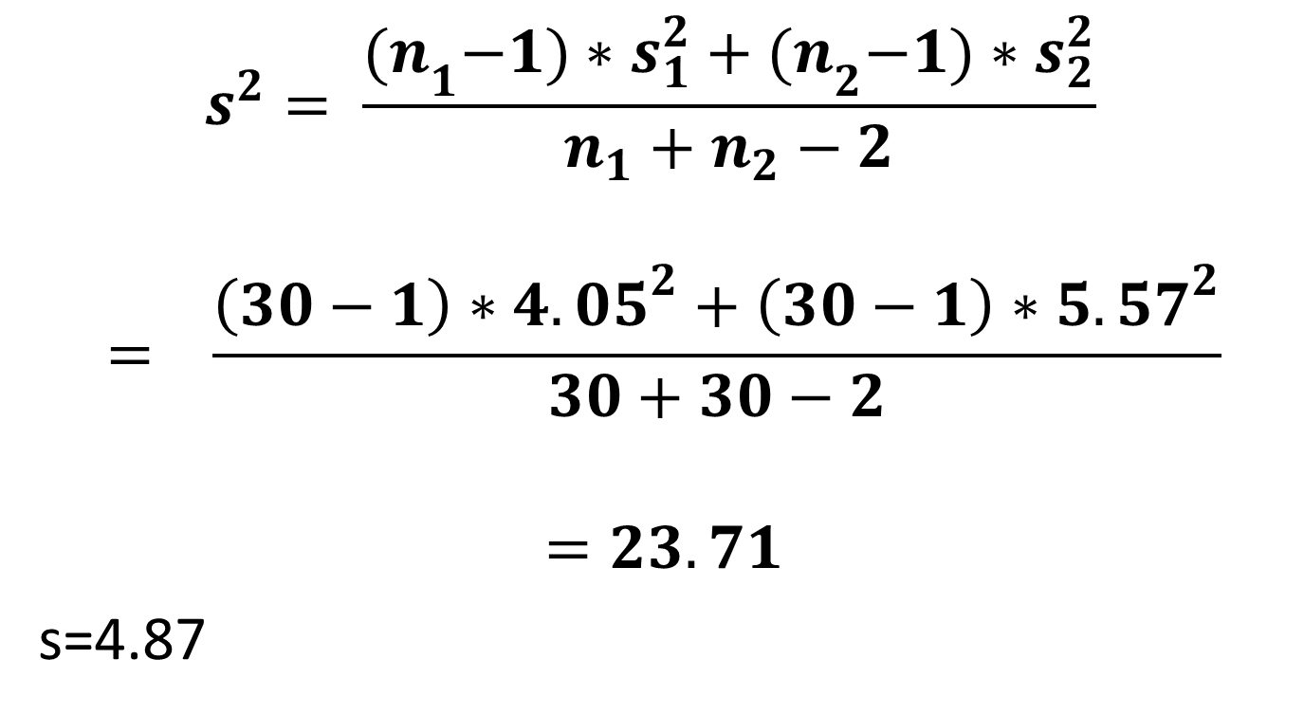
Pooled Standard deviation
$$s^{2}= \frac{{(n}_{1}−1)∗s_{1}^{2}+{(n}_{2}−1)∗s_{2}^{2}}{n_{1}+n_{2}−2}$$
$$= \frac{\left(30−1\right)∗{4.05}^{2}+\left(30−1\right)∗{5.57}^{2}}{30+30−2}$$
$$=23.71$$
s=4.87

Slide 4
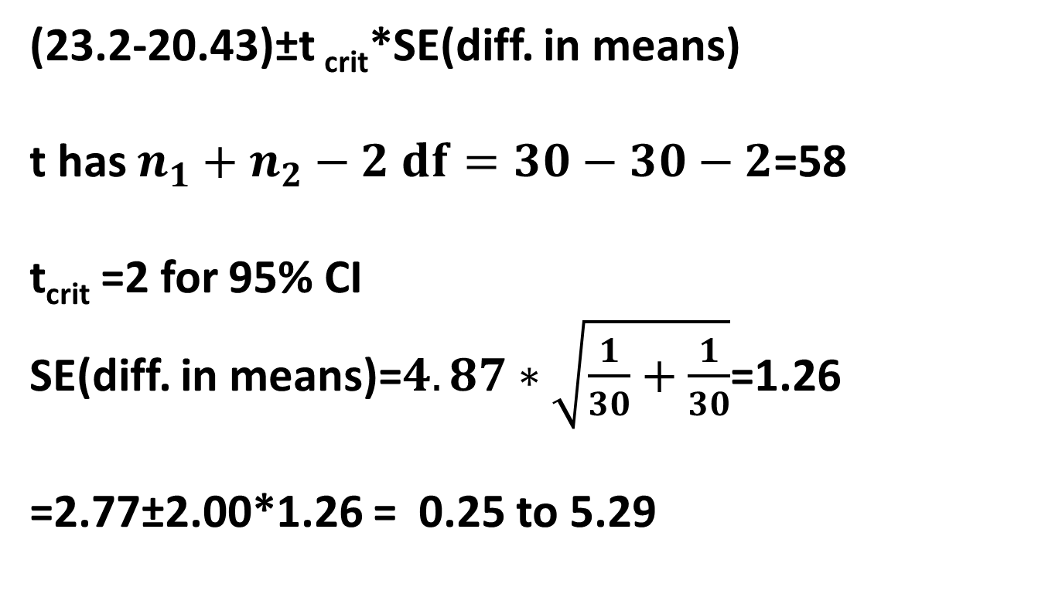
95% Confidence Interval
(23.2-20.43)±t _{crit}*SE(diff. in means)
t has $n_{1}+n_{2}−2 df=30−30−2$=58
t_{crit} =2 for 95% CI
SE(diff. in means)=$4.87∗\sqrt{\frac{1}{30}+\frac{1}{30}}$=1.26
=2.77±2.00*1.26 = 0.25 to 5.29

Slide 5
Hypotheses
H₀: There is no difference between the population(or long term) average speed of the two processors
H_{a}: There is a difference between the population (or long term) average speed of the two processors

Slide 6

Test statistic
t=$\frac{\left(23.2−20.43\right)−0}{4.87∗\sqrt{\frac{1}{30}+\frac{1}{30}}}=2.20,$
$$df=30+30−2=58$$

Slide 7
Interpretation
Critical t=2.00
As 2.20 is outside the range [-2,2], we have enough evidence to reject the null hypothesis and conclude that there is a difference between the two population average processor speeds.

Slide 8
Test statistic vs CI
The confidence interval does not include zero as you would have expected since we rejected the null hypothesis.

Slide 9
Input-Output

Slide 10
Minitab output
Two-sample T for Input-Output
Processor N Mean StDev SE Mean
Type A 30 7.86 1.34 0.25
Type B 30 7.57 1.62 0.29
Difference = mu (Type A) - mu (Type B)
Estimate for difference: 0.287
95% CI for difference: (-0.481, 1.054)
T-Test of difference = 0 (vs not =): T-Value = 0.75 P-Value = 0.458 DF = 58
Both use Pooled StDev = 1.4857

Slide 11
Interpretation
The p value 0.458 > 0.05
Therefore there is not sufficient evidence to reject the null hypothesis.
The confidence interval (-.48 to 1.05) contains 0.

